Slide 1
Storytelling captions

Slide 2
Why are they important?
Although you want your photos to speak your themselves, you also want to provide more information about them when you can/
Caption writing is an essential part of a photojournalist’s job
They provide context and information that is valuable for viewers to have
A really great caption can make your photos more interesting and makes you look like you’ve done your homework and know what you’re talking about

Slide 3
Basic formatting
Basic captions include the 5 W’s that you probably learned in English class: who, what, when, where and why
Who or what is in the photo?
What are they doing?
When and where was this photo taken?
What’s the importance of the photo?
Your captions should be written in complete sentences and in present tense.

Slide 4
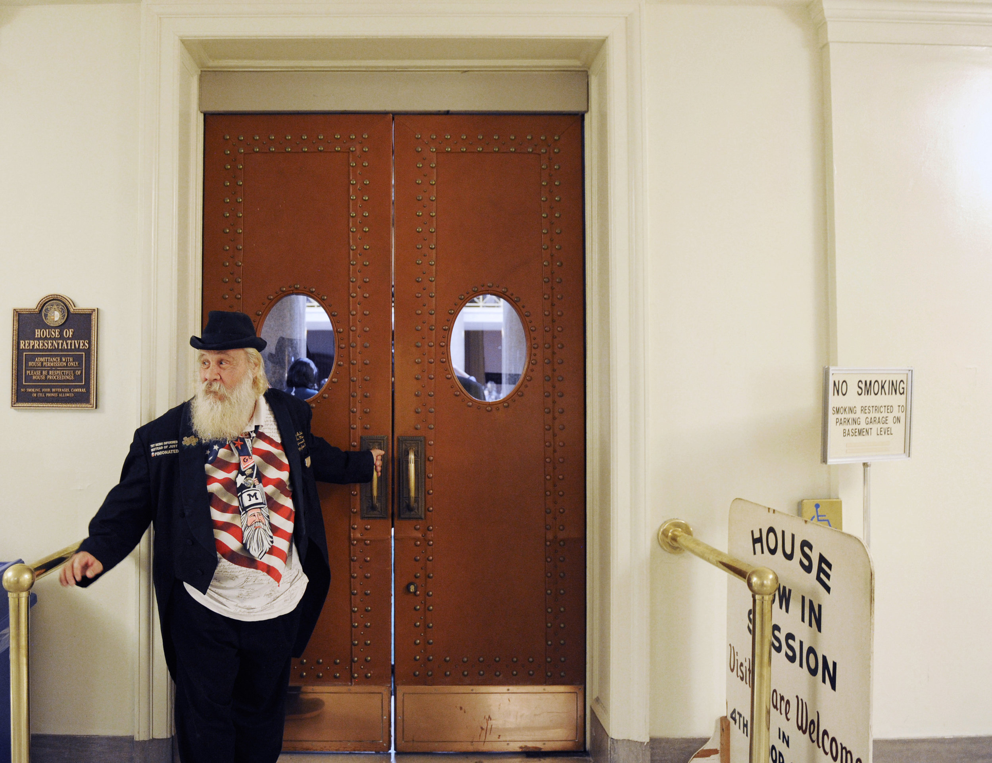
Leonard Steinman, who was a Democratic candidate for governor of Missouri in the 2016 election, attempts to open the door for a spectator of Governor Greitens' State of the State Address on Tuesday, Jan. 17, 2017 in Jefferson City, MO. Steinman said Greitens kept his speech "short, sweet, and to the point.”
©Monique Woo

Slide 5
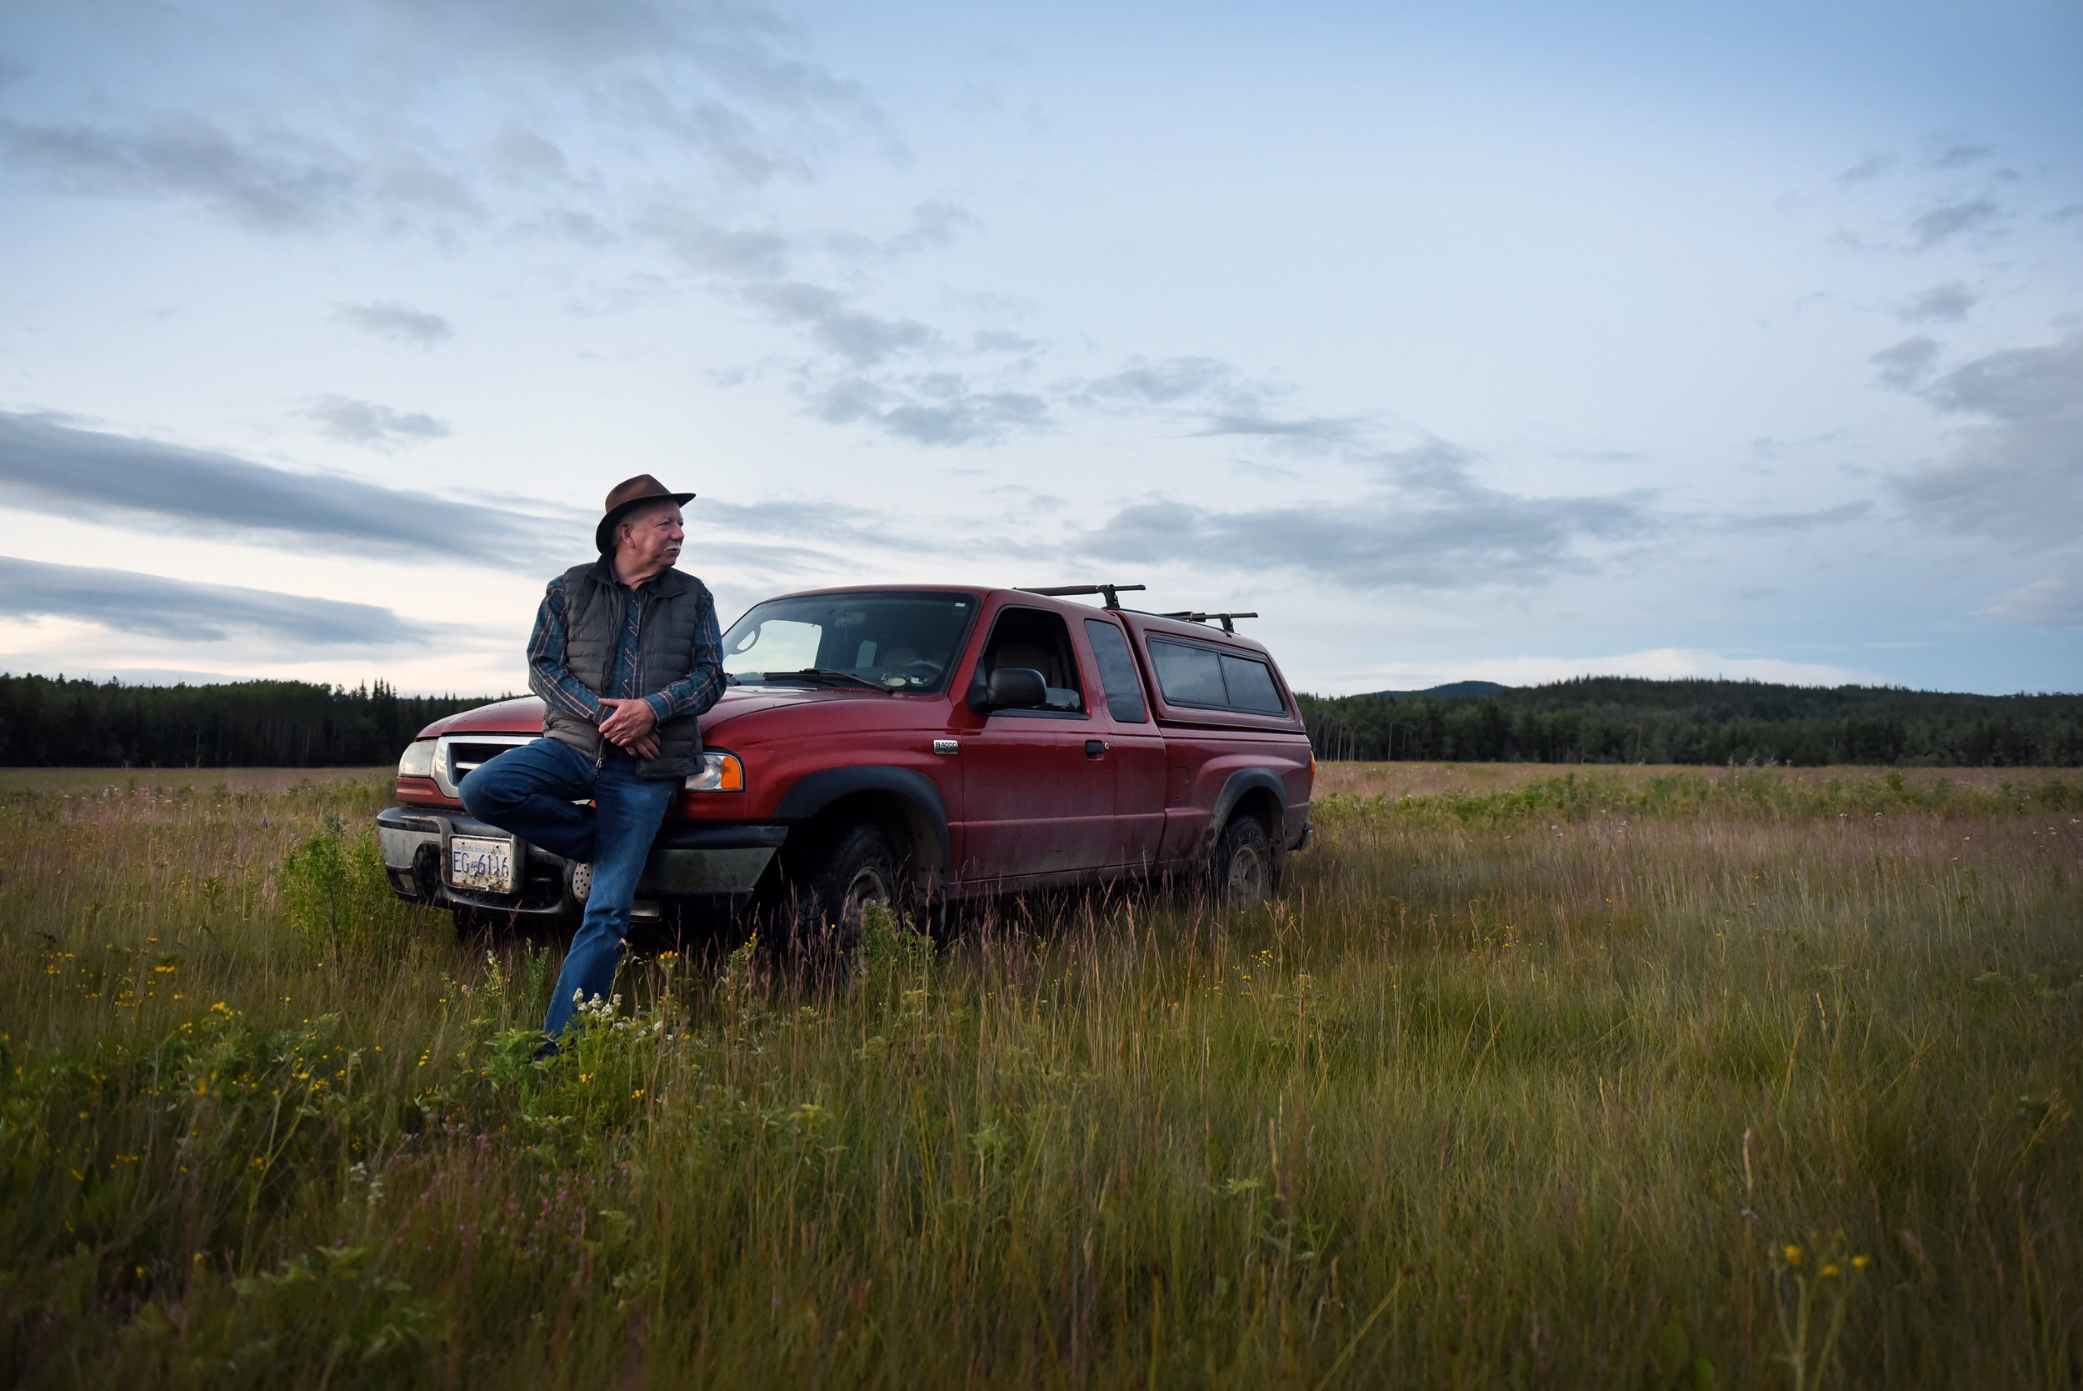
Mike Robertson, senior policy advisor for the Cheslatta Carrier Nation in central British Columbia, enjoys the acres of uncut fields in his backyard. Robertson lives by Mollice Lake, where he canoes and fishes during the summer. His Cheslatta Indian name is 'Dlooncho' which means “packrat” in the Carrier Language.

Slide 6
Basic formatting
Use this format when necessary because you don’t always want to just state the obvious
If you think people won’t know what’s going on, say what is in the caption.
Sometimes this style of caption doesn’t always work, so don’t try to always make your captions look like this.

Slide 7
Basic formatting
But you ALWAYS note in the caption if a photo was manipulated of if unusual photo techniques were used.
If it’s not obvious you controlled the situation or changed things around in Photoshop, you must label your photo as a “photo illustration”
Example: “In this photo illustration, ________”

Slide 8
Taking them to the next level
There is so much flexibility with what you can ADD to a caption.
Normally, captions are 1-2 sentences, but they can be long if it adds to the photo
Include extra details that you know about your subjects or the location
Add interesting or relevant quotes

Slide 9
What not to do
Don’t use verbs or verb phrases like “looks on, “poses” or “is pictured above.” Instead just talk about who the person is.
Don’t editorialize or make assumptions about what someone is thinking in your photos. E.g. An angry neighbor or an excited employee.
Don’t characterize things in the photo as “beautiful,” “dramatic,” “horrifying,” etc.

Slide 10
Examples projects with
in-depth captions:
“The house autism built” by Carolyn Van Houten
“Our own land” by Zhihan Huang
“River dreaming” by Marlena Sloss
“Flock of doves” by Gabriel Scarlett

Slide 11
In-class activity
Now that you know more about caption writing, we will be working on captioning some photos we know will be in your final edit of your project

Slide 12
Homework
Keep making pictures for your final project
You should know what you need to work on and get for your it after this week’s critique.
Be sure to continue gathering caption information though! The more information, the better.

