Slide 1
Basics of photography: Part Two

Slide 2
Creating interesting compositions
We’re going to be focusing on learning more about the techniques in making ”good” composition.

Slide 3
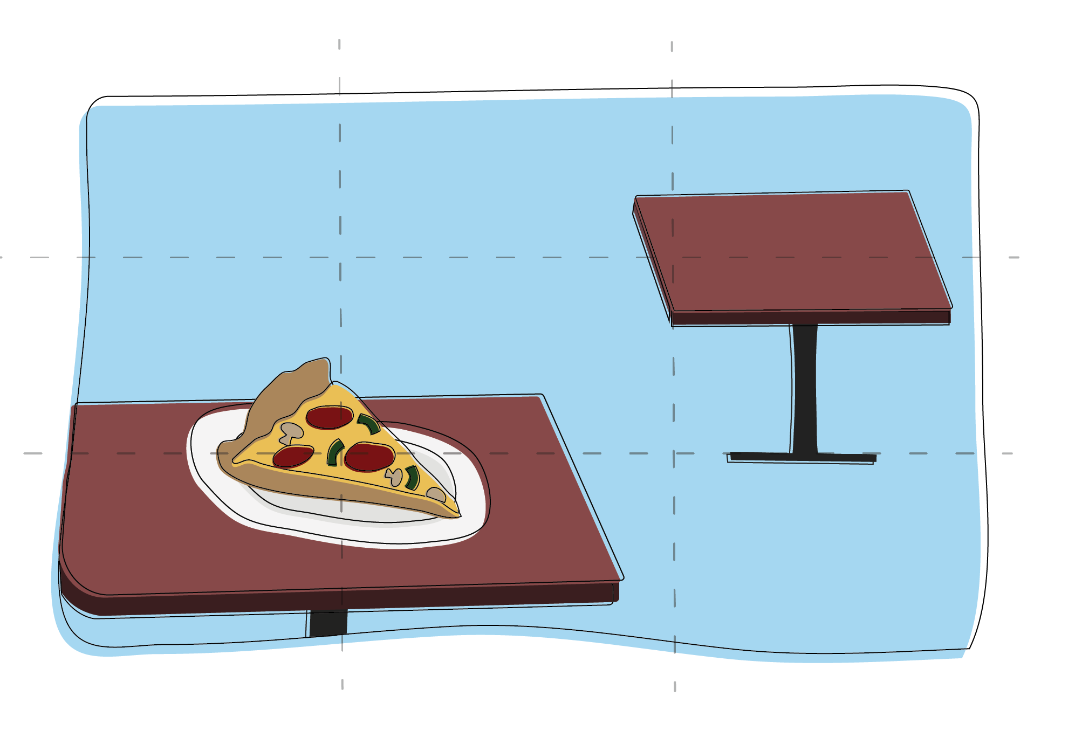
Rule of Thirds

Slide 4
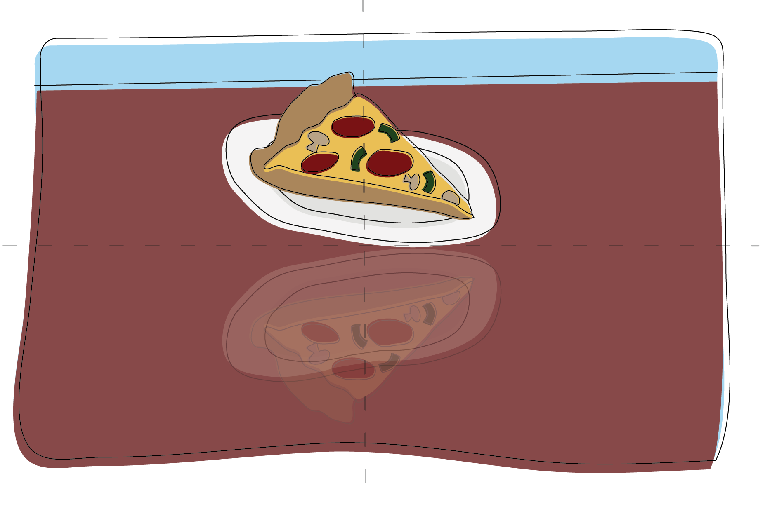
Centering & Symmetry

Slide 5
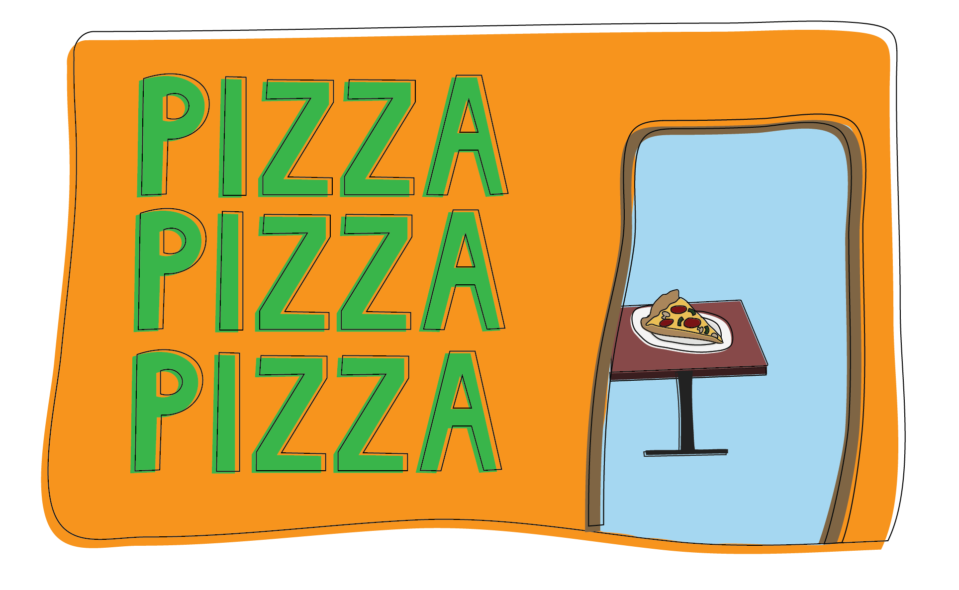
Layering & Frame within a Frame

Slide 6
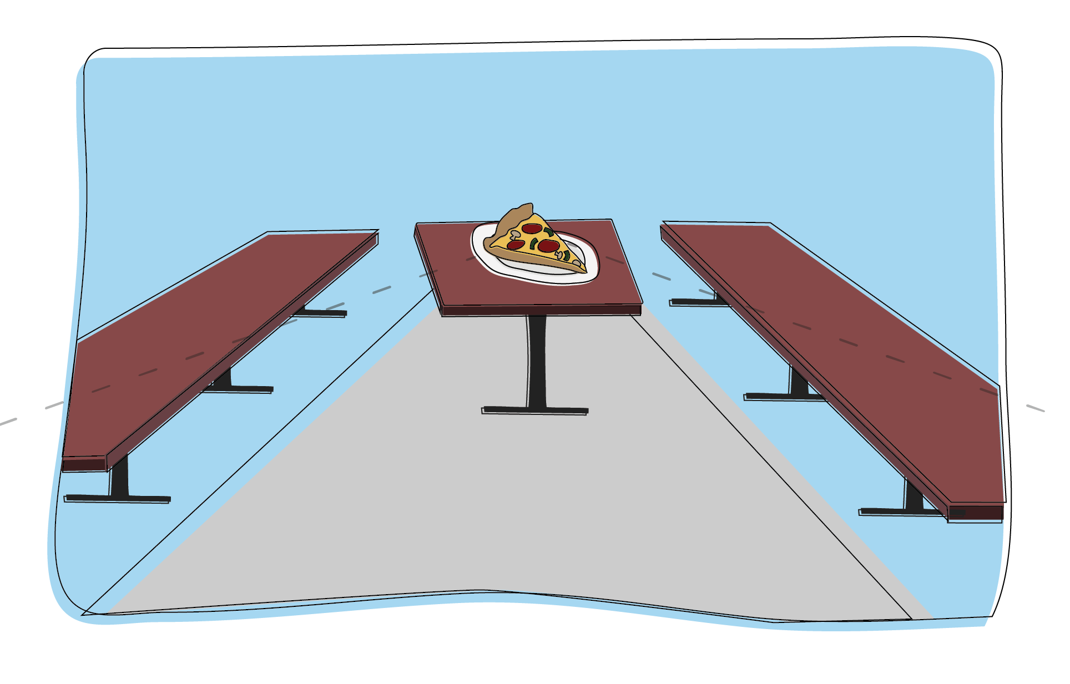
Leading Lines

Slide 7
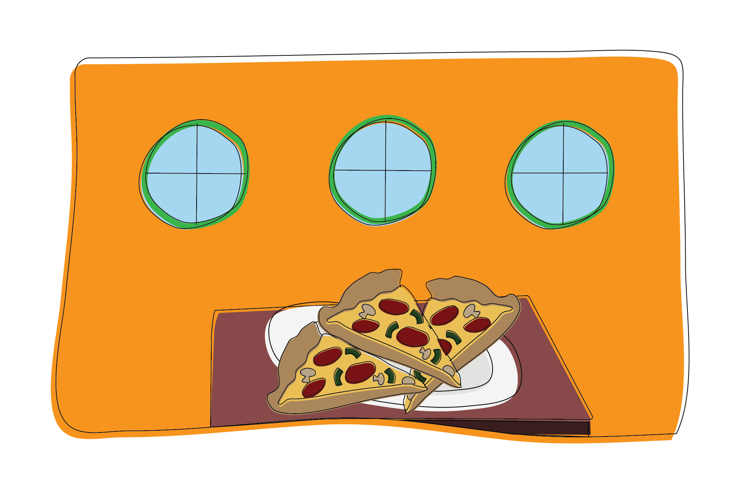
Rule of Odds

Slide 8
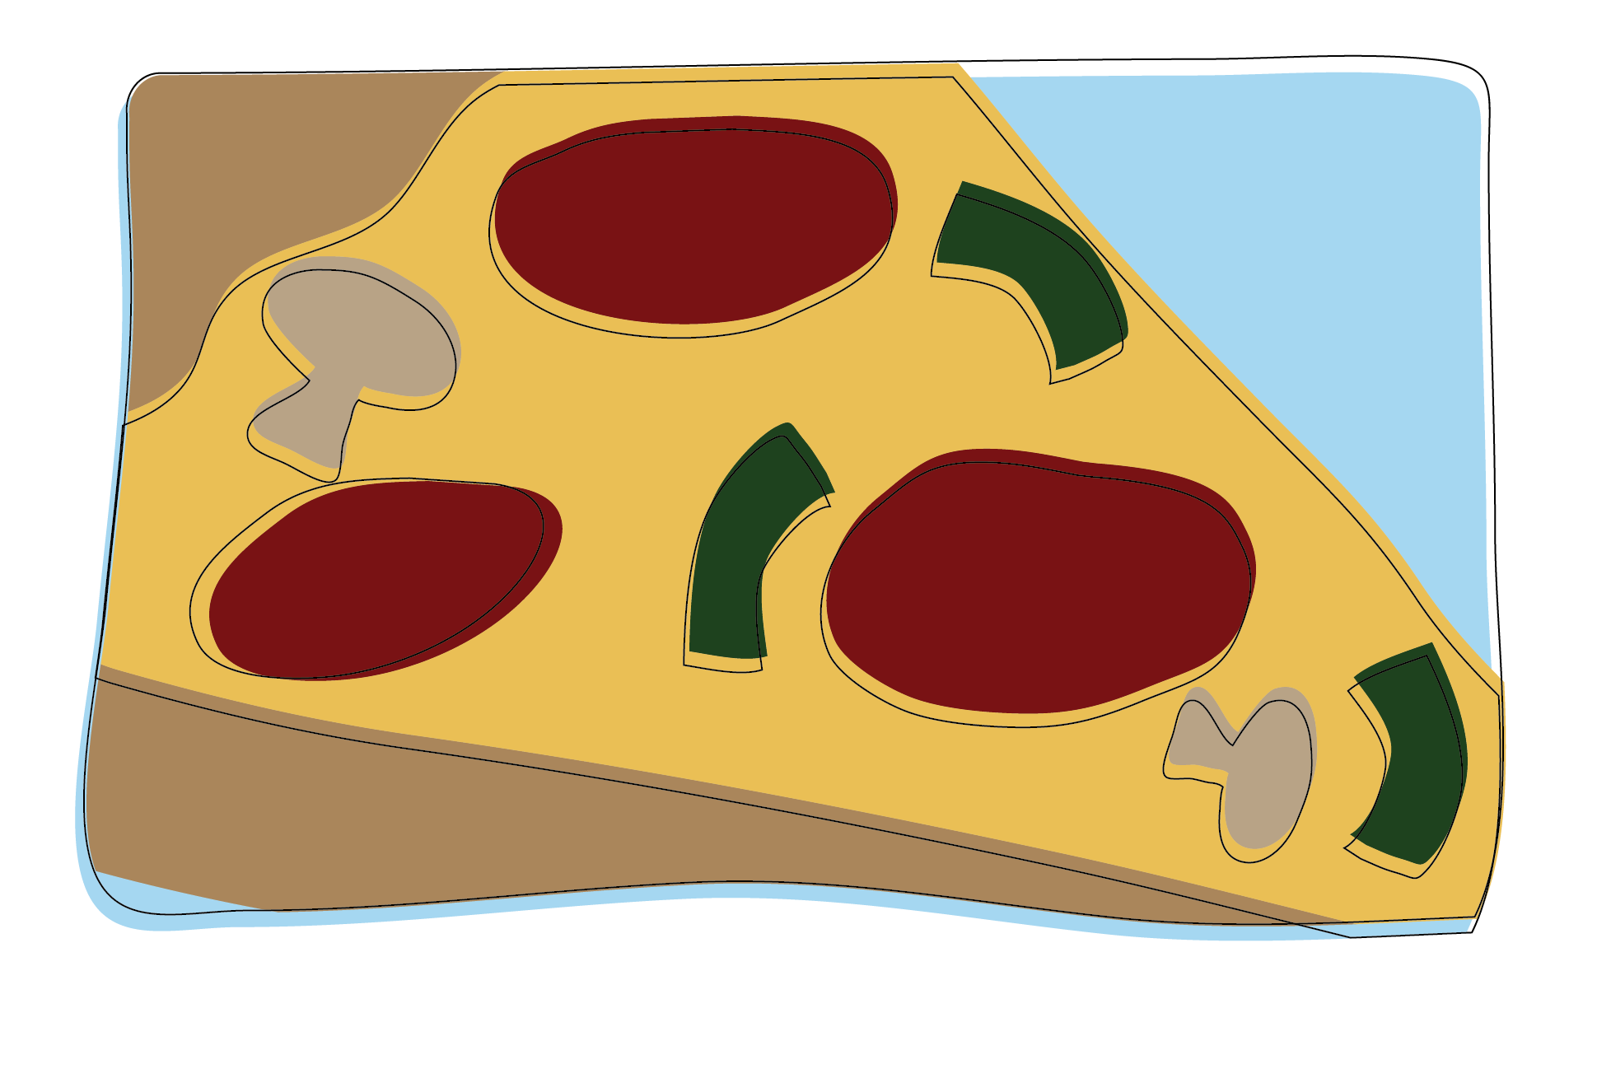
Fill the Frame

Slide 9
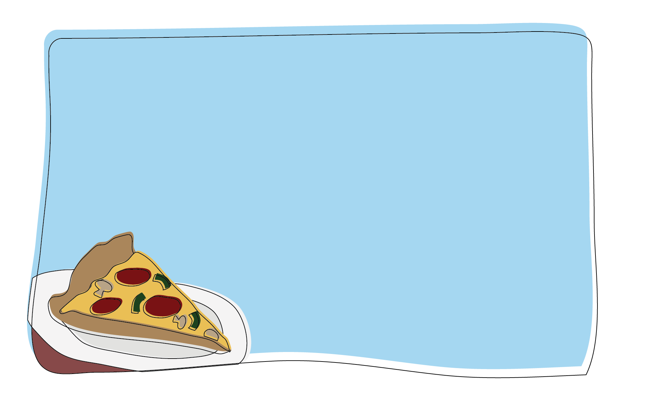
Leave Negative Space

Slide 10
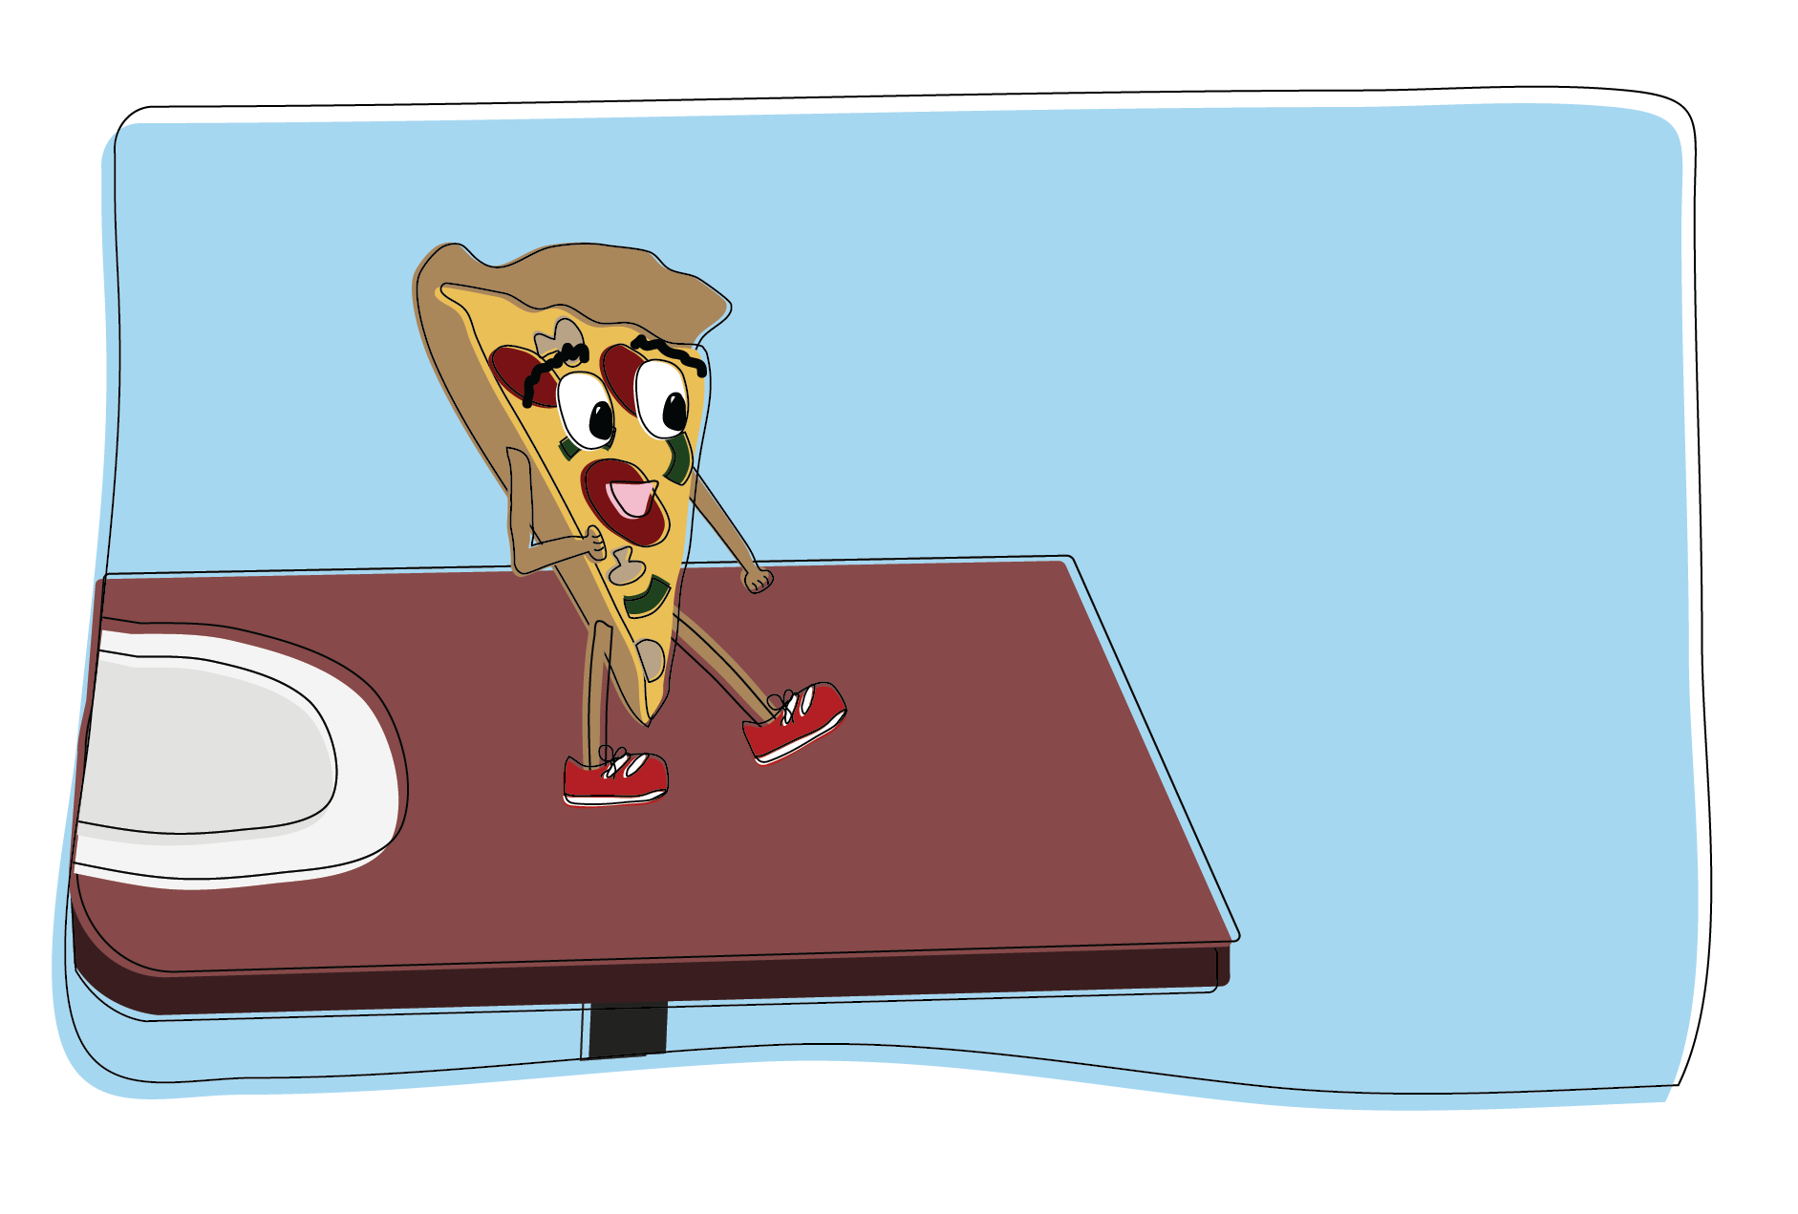
Rule of Space

Slide 11
Photographers who religiously use these techniques in their own work:
Matt McClain
Jeenah Moon
Sarah Silbiger
Jovelle Tomayo
Michael Noble Jr.
Tom Brenner

Slide 12
In-class activity
We will be practicing our techniques first without using our cameras and then an activity that will get your blood flowing

Slide 13
Finger framing
Using your hands, you’re going to make a rectangle by making “L’s” with your pointing finger and thumb.
I will show you different images, and you’ll have to figure out the best way to frame the main subject.

Slide 14
Musical photos
You will be walking around the while music plays.
When the music stops, you will have to stop and take a photo of whatever is in front of you.
Try to find a main subject and practice the composition skills you we just talked about.

Slide 15
Homework
We’re going to take the same idea as last week’s homework and make it a little more interesting.
You will be given a list of things to find and photograph, just like a scavenger hunt.
The things listed are all things that are personal to you
Make sure you’re practicing the composition techniques!

